Slide 1

Visual Media Program
(Commercial Video and Photography)
Bliss Holloway - Coordinator
Program Name
Goes Here
Presenter Name Goes Here
Notes:
Welcome, introduce yourself and the program. Feel free to share about your education/career background, how long you’ve been teaching, etc.

Slide 2
What is the program?
Visual Media at Seattle Central Creative Academy
The Visual Media program is a rigorous 2-year, lockstep program which leads to an AAS degree and provides the framework for a strong portfolio in photography and commercial video production. It focuses on fundamental photo and filmmaking skills, career preparation, and industry standard post-production software and techniques.
Where is this program offered?
We are at:
Seattle Central College
(Part of the Seattle Central Creative Academy)
Entry Requirements
Admission to Seattle Central College
College Composition (English 101) and Pre-Algebra (MAT 081)
Portfolio Review

Slide 3
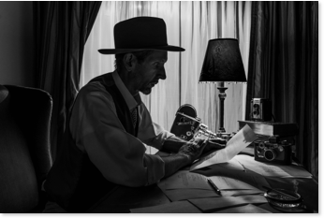

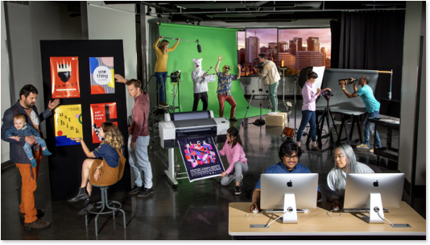
Work!

Slide 4
What do you learn?
All faculty are industry professionals from the commercial worlds of Filmmaking and Photography. Many varied backgrounds.
Assignments are created to mimic the kind of client work that our graduates face in the industry. – Real, professional-level challenges!
Along the way you will examine concepts, ask questions, solve creative problems, and push the boundaries of traditional media using the power of still and motion imagery.
Our program integrates emerging technologies to keep students current by evolving our curriculum to respond to industry needs and standards.
Learn to expand your knowledge both individually and in small teams to craft creative solutions from aesthetic conception to final application.

Slide 5
Education Pathway
The curriculum
30 Courses over two years – 20 Credits per quarter
Lockstep, only start in the Fall
Classes meet once a week, five days a week from 9:00am to 2:00pm,
except Friday 9:00am to 3:00pm for New Media.
11-week quarters with no classes during the summer
Required Internship, 3 credits, 99 hours
Classes are a mix of lecture, demonstrations, critiques and lab time.
Two-year program, Associate of Applied Science degree
Upside down articulation with Western Washington and Evergreen

Slide 6
Courses

Slide 7
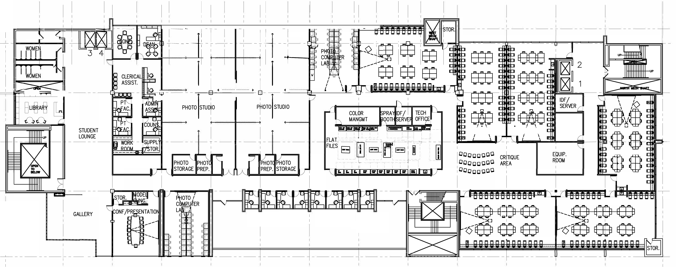
Our Space

Slide 8
Q & A
This is what we do
http://seattlecentralcreativeacademy.com/
https://www.instagram.com/creative_academy/
https://www.instagram.com/creative_academy_vme/
Contact Information
Email: bliss.Holloway@seattlecolleges.edu
Phone: 206-934-4351

Slide 9

Return to Main Session
(select “Leave Breakout Room” to return)

Slide 10
Extra blank slide (if needed)

